Slide 1

Self-Development and Assessment:SWOT Analysis
Sem-4 Professional Grooming & Personality Development (303193252)

Slide 2
Learning Objectives
By the end of the session, students will be able to:
Define SWOT and its four components.
Explain the purpose of SWOT analysis.
Demonstrate how to perform SWOT analysis step by step.
Apply SWOT to real-life personal and professional contexts.

Slide 3
Topics to be Covered
1.Introduction
2.What is SWOT
3.Purpose
4.Steps
5.Example
6.Activity
8.Conclusion
9.Learning outcome

Slide 4
What is SWOT Analysis?
• Strengths: Internal positive qualities.
• Weaknesses: Internal limitations.
• Opportunities: External factors to explore.
• Threats: External risks or challenges.
➡ SWOT helps in strategic planning, career assessment, and organizational analysis.

Slide 5
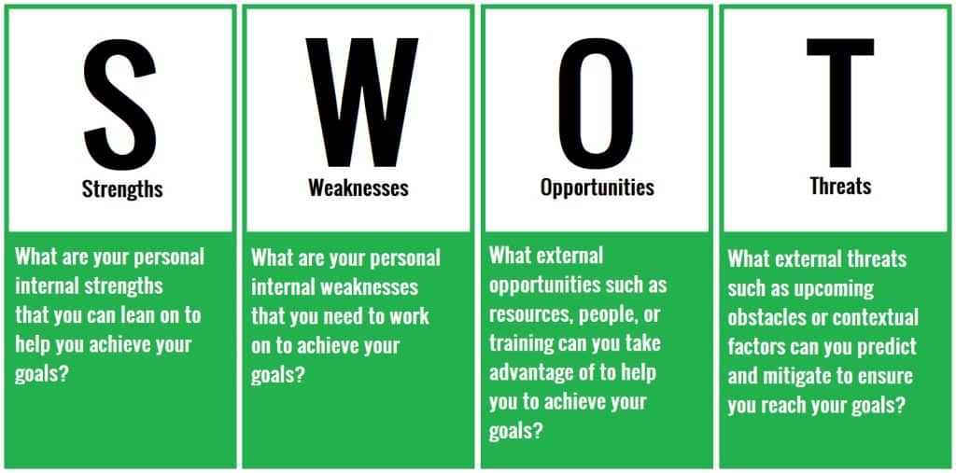

Slide 6
Purpose of SWOT Analysis
• To assess the current position of an individual or organization.
• To identify areas of improvement.
• To align strengths with opportunities.
• To manage risks and overcome weaknesses.

Slide 7
When SWOT is Required
• Before starting a new project or job.
• During career or academic planning.
• While launching a product or business.
• For self-development and goal setting.
• During performance review or strategy update.

Slide 8
Steps to Conduct SWOT Analysis
Identify internal Strengths and Weaknesses.
Identify external Opportunities and Threats.
Analyze the connections (e.g., how strengths can reduce threats).
Create an Action Plan for improvement and growth.
Review regularly and update based on changes.

Slide 9
Example – Personal SWOT Analysis (Student)
Strengths – Good communication, teamwork, leadership.
Weaknesses – Poor time management, procrastination.
Opportunities – Internship programs, skill workshops.
Threats – Competition, changing job trends.

Slide 10
Example – Organizational SWOT (Apple Inc.)
Strengths – Strong brand, loyal customer base.
Weaknesses – High product prices.
Opportunities – Growth in emerging markets.
Threats – Intense competition, imitation.

Slide 11
Example – Career Growth SWOT
Strengths – Technical knowledge, creativity.
Weaknesses – Lack of public speaking experience.
Opportunities – Networking, training sessions.
Threats – Automation, limited job openings.

Slide 12
Activity
Activity: Create a SWOT for a Known Brand
Objective: Help students apply SWOT analysis by evaluating a familiar company.
Steps:
Divide into Small Groups (3–5 students each).
Assign or Let Groups Choose a Brand (e.g., McDonald’s, Apple, Nike, Netflix).

Slide 13
Each Group Creates a SWOT Chart:
Strengths – What makes the brand successful?
Weaknesses – Where could it improve?
Opportunities – New markets, trends, or tech?
Threats – Competitors, changing customer needs?

Slide 14
Present & Discuss: Each group presents their SWOT to the class.
Reflection Questions:
What surprised you in your analysis?
How can companies use SWOT to plan ahead?

Slide 15
Background:
McDonald’s Corporation is one of the world’s largest and most recognized fast-food chains, serving over 69 million customers daily across more than 100 countries. Known for its burgers, fries, and speedy service, McDonald’s relies heavily on its global franchise model.

Slide 16
Context
In recent years, McDonald’s has faced increasing pressure from health-conscious consumers, changing dietary trends, and rising operational costs. At the same time, the company has been innovating through digital ordering, delivery partnerships, and menu adjustments. The management is considering a new strategy to retain market leadership and adapt to evolving consumer preferences.

Slide 17
Task:
As a business consultant, you are asked to perform a SWOT Analysis of McDonald’s to guide strategic planning. Use the facts provided and your own insights.

Slide 18
SWOT Analysis
Strengths:
Global brand recognition
Large franchise network
Consistent service and menu worldwide
Strong marketing and advertising power
Advanced logistics and supply chain

Slide 19
Weaknesses:
Public image linked to unhealthy food
High employee turnover
Dependency on franchisees for quality control
Limited menu diversity in some markets
Past criticism for labor practices

Slide 20
Opportunities:
Growing demand for plant-based and healthy food
Tech-driven ordering and personalization
Expansion in developing markets
Eco-friendly packaging and sustainability programs
Strategic partnerships (e.g., Uber Eats, DoorDash)

Slide 21
Threats:
Rising competition from fast-casual brands (e.g., Chipotle)
Regulatory pressure on health, wages, and environment
Shifts in consumer behavior toward local or organic food
Fluctuating commodity and labor costs
Reputational risk from social media and lawsuits

Slide 22
Discussion Questions:
How can McDonald’s turn its weaknesses into strengths?
Which opportunities should it prioritize for the next 5 years?
How can McDonald’s address threats like the healthy eating trend?
What role does innovation play in staying competitive?

Slide 23
SWOT Analysis: Taylor Swift
Strengths
Musical Versatility: Successfully transitioned across genres (country, pop, indie, alternative).
Strong Songwriting Skills: Acclaimed for deeply personal and relatable lyrics.
Massive Fanbase: Loyal global following (“Swifties”) ensures sustained popularity.

Slide 24
Strength
Business Acumen: Re-recording of her old albums (Taylor’s Versions) is a strategic power move for ownership and revenue.
Brand Partnerships: Collaborations with major brands (e.g., Apple, Coca-Cola) add to her marketability.
Cultural Influence: Recognized as a feminist voice and advocate for artists' rights.

Slide 25
Weaknesses
Overexposure: Constant media attention can lead to public fatigue or backlash.
Polarizing Public Image: While beloved by many, her outspoken views have drawn criticism from some.
High Expectations: Every new release is under intense scrutiny from fans, critics, and media.
Personal Life in Spotlight: Relationships and feuds often become tabloid headlines, distracting from her work.

Slide 26
Opportunities
Global Touring: Record-breaking Eras Tour boosts visibility and revenue.
Film & TV: Potential to expand further into directing, producing, or acting (she's directed short films and may explore more).

Slide 27
Social Impact & Philanthropy: Can leverage influence for social justice and charitable causes.
New Ventures: Opportunities in fashion, publishing (autobiography or poetry), or tech (apps, platforms).

Slide 28
Threats
Media Controversies: Social media misinterpretations or old controversies can resurface.
Competitive Industry: Newer artists and evolving trends could impact dominance.
Health & Burnout: Demanding schedule from touring, creating, and promoting can take a toll.
Intellectual Property Issues: Despite re-recordings, music rights and licensing can still pose challenges.

Slide 29
Using SWOT Results
• Develop personal development plans.
• Match strengths with external opportunities.
• Convert weaknesses into learning goals.
• Create proactive strategies to manage threats.

Slide 30
Assessment
Formative Assessment:
• SWOT Worksheet activity (individual reflection).
• Peer discussion and feedback session.
Summative Assessment:
• Submission of personal SWOT report with action plan.

Slide 31
Engagement Strategies
• Interactive Activity: Students create their own SWOT chart.
• Group Discussion: Compare SWOT analysis of different industries.
• Case Study: SWOT of a popular brand.
• Role Play: Using SWOT for career interviews.

Slide 32
Self-Reflection
Ask students to take 5–10 minutes to reflect on their personal, academic, and professional traits. Encourage honest and constructive self-evaluation. Prompt them with guiding questions such as:
What are you naturally good at?
What skills do you need to improve?
What upcoming opportunities could help your career?
What obstacles or challenges do you face?

Slide 33
Creating the SWOT Chart
Students draw a 4-quadrant chart on paper or fill in a provided template:
Strengths | Weaknesses
(List personal strengths) | (List areas of improvement)
Opportunities | Threats
(List external opportunities)
(List potential challenges)

Slide 34
Sharing and Discussion
Students share one key insight from their SWOT chart with the class or in small groups.
The instructor facilitates a discussion, highlighting how understanding one’s SWOT can guide career planning, decision-making, and goal setting.
Constructive feedback is provided by peers and the instructor to promote mutual learning.

Slide 35
Action Planning
Once the SWOT chart is completed, students develop a Personal Action Plan by answering:
How can I use my strengths more effectively?
What steps can I take to overcome my weaknesses?
Which opportunities can I pursue in the next 6 months?
How can I minimize or manage my threats?
This reflection turns the SWOT chart into a practical development tool.

Slide 36
References
MindTools. (2024). SWOT Analysis – How to Develop a Strategy for Success.
Harvard Business Review – Using SWOT in Business Strategy.
Robbins, S.P., & Judge, T.A. (2022). Organizational Behavior.
Canva Education Templates – Visual SWOT Charts.

Slide 37
Video Links
1. SWOT Analysis Explained – https://www.youtube.com/watch?v=GNXYI10Po6A
2. Personal SWOT Analysis for Career Planning – https://www.youtube.com/watch?v=3Tv0A1K3w2E
3. How to Use SWOT for Business Success – https://www.youtube.com/watch?v=0i6Yv0xDczA

Slide 38
Video Links
4. SWOT Analysis in Real Life – Case Studies – https://www.youtube.com/watch?v=yuw1Z5yD4G8
5. Developing Self Awareness through SWOT – https://www.youtube.com/watch?v=KMEeXhHjbdE

Slide 39
Learning Outcomes
By the end of the session, students will be able to:
Identify Strengths, Weaknesses, Opportunities, and Threats.
• Conduct a structured SWOT analysis.
• Interpret findings for strategic decisions.
• Use SWOT as a lifelong self-assessment tool.

Slide 40
Conclusion
SWOT Analysis helps identify strengths, weaknesses, opportunities, and threats effectively.
It enhances self-awareness and supports strategic decision-making.
Encourages goal-oriented planning and continuous improvement.
Assists in adapting to changes and building on competitive advantages.

Slide 41
Conclusion
Promotes a proactive and analytical mindset for personal and professional growth.
Acts as a foundation for long-term success and sustainable development.

Slide 42
Thank You

